Slide 1
NEO4J CYPHER TUTORIAL WITH PYTHON
Max ,Min operator
Tutorial 59

Slide 2
Max Operator
Definition
max() returns the maximum value in a set of values.
Any null values are excluded from the calculation.

Slide 3
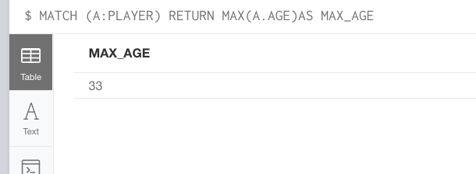
Distinct Operator
FIND THE AVG AGE
Using NEO4J BROWSER
CREATE (A:PLAYER{NAME:"MESSI",AGE:31}),(B:PLAYER{NAME:"CR7",AGE:33}),(C:PLAYER{NAME:"NEYMAR",AGE:26}),(D:PLAYER{NAME:"POGBA",AGE:26}),(E:PLAYER{NAME:"EMBAPPE",AGE:21})

Slide 4
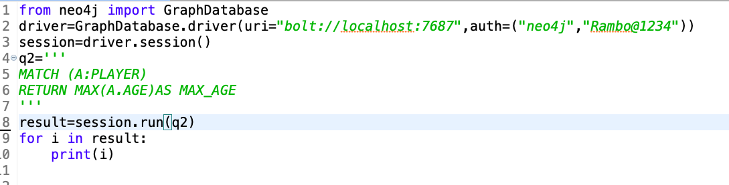
MAX Operator
FIND THE MAX AGE
Using PYTHON DIE

Slide 5
Min Operator
Definition
min() returns the minimum value in a set of values.
Any null values are excluded from the calculation.

Slide 6

MIN Operator
FIND THE MIN AGE
Using NEO4J BROWSER

Slide 7
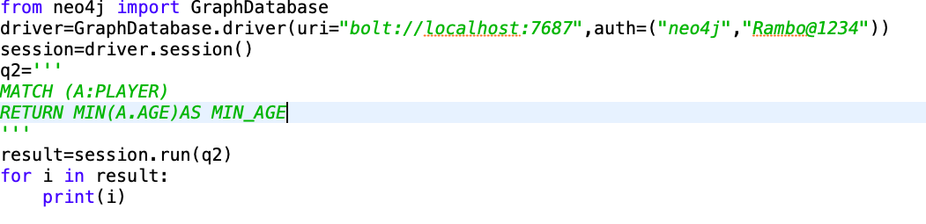
MIN Operator
FIND THE MIN AGE
Using PYTHON DIE

